Slide 1
Statistical Analysis of Life Expectancy Dataset
SUBMITTED BY :-
Avinandan Patel(215280043) SylvIa Vincent(215280005)
Vishakha Verma(215280019) Inderesh Singh(215280011)
Harsh jaiswal(215280022) Raj Khandagale(215280002)

Slide 2
ABOUT DATASET:

Slide 3
All about the dataset
The Global Health Observatory (GHO) data repository under World Health Organization (WHO) keeps track of the health status as well as many other related factors for all countries
The data-sets are made available to public for the purpose of health data analysis.
The data-set related to life expectancy, health factors for 193 countries has been collected from the same WHO data repository website and its corresponding economic data was collected from United Nation website.
Among all categories of health-related factors only those critical factors were chosen which are more representative.
It has been observed that in the past 15 years , there has been a huge development in health sector resulting in improvement of human mortality rates especially in the developing nations in comparison to the past 30 years

Slide 4
Structure of data set
DIMENTIONS OF DATA
Number of sample points: = 2938
Number of Variables: = 22
VARIABLES DISCRIPTION
Nominal Variable:-
Country: The country in which the indicators are from (i.e. United States of America or Congo
Status: Whether a country is considered to be ‘Developing’ or ‘Developed’ by WHO standards
Ordinal Variable:-
Year: The calendar year the indicators are from (ranging from 2000 to 2015)
BMI Average Body Mass Index (BMI) of a country’s total population

Slide 5
RATIO
Life Expectancy: The life expectancy of people in years for a particular country and year
Adult Mortality: The adult mortality rate per 1000 population
Infant Deaths: Number of infant deaths per 1000 population
Alcohol: A country’s alcohol consumption rate measured as liters of pure alcohol consumption per capita
Alcohol: A country’s alcohol consumption rate measured as liters of pure alcohol consumption per capita
Hepatitis b: Number of 1 year olds with Hepatitis B immunization over all 1 year olds in population
Measles: Number of reported Measles cases per 1000 population
Under five deaths: Number of people under the age of five deaths per 1000 population
Polio: Number of 1 year olds with Polio immunization over the number of all 1 year olds in population
Total Expenditure: Government expenditure on health as a percentage of total government expenditure
Diphtheria: Diphtheria tetanus toxoid and pertussis (DTP3) immunization rate of 1 year olds
HIV/Aids: - deaths per 1000 live births caused by HIV/AIDS for people under 5
GDP- Gross Domestic Product per capita
population:- population of a country
Thinness 10-19 years :- rate of thinness among people aged 10-19
thinness 5-9 years :- rate of thinness among people aged 5-9
income composition of resources :- Human Development Index in terms of income composition of resources
Schooling :- average number of years of schooling of a population

Slide 6
DATA CLEANING
MISSING VALUE DETECTION
To find missing values sum(is.na()) provides total number of missing values.
In our data we got 2563 NA values out of total 2938 observations.
DEALING WITH MISSING VALUES
Dropping this value will result in loss of 50% of data.
Hence replacing them with median found to be appropriate as each variables are right skewed or left skewed or normally distributed.

Slide 7
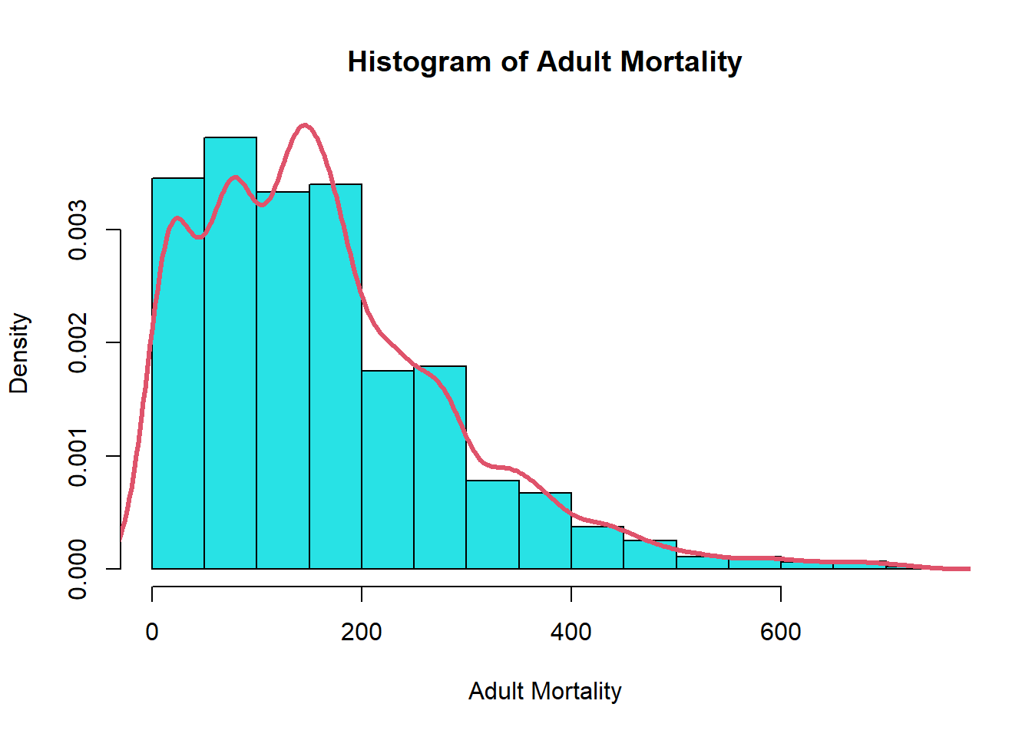
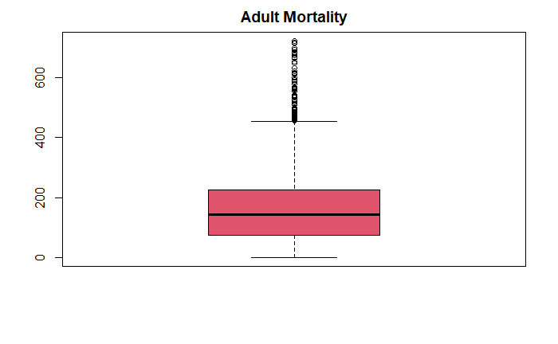
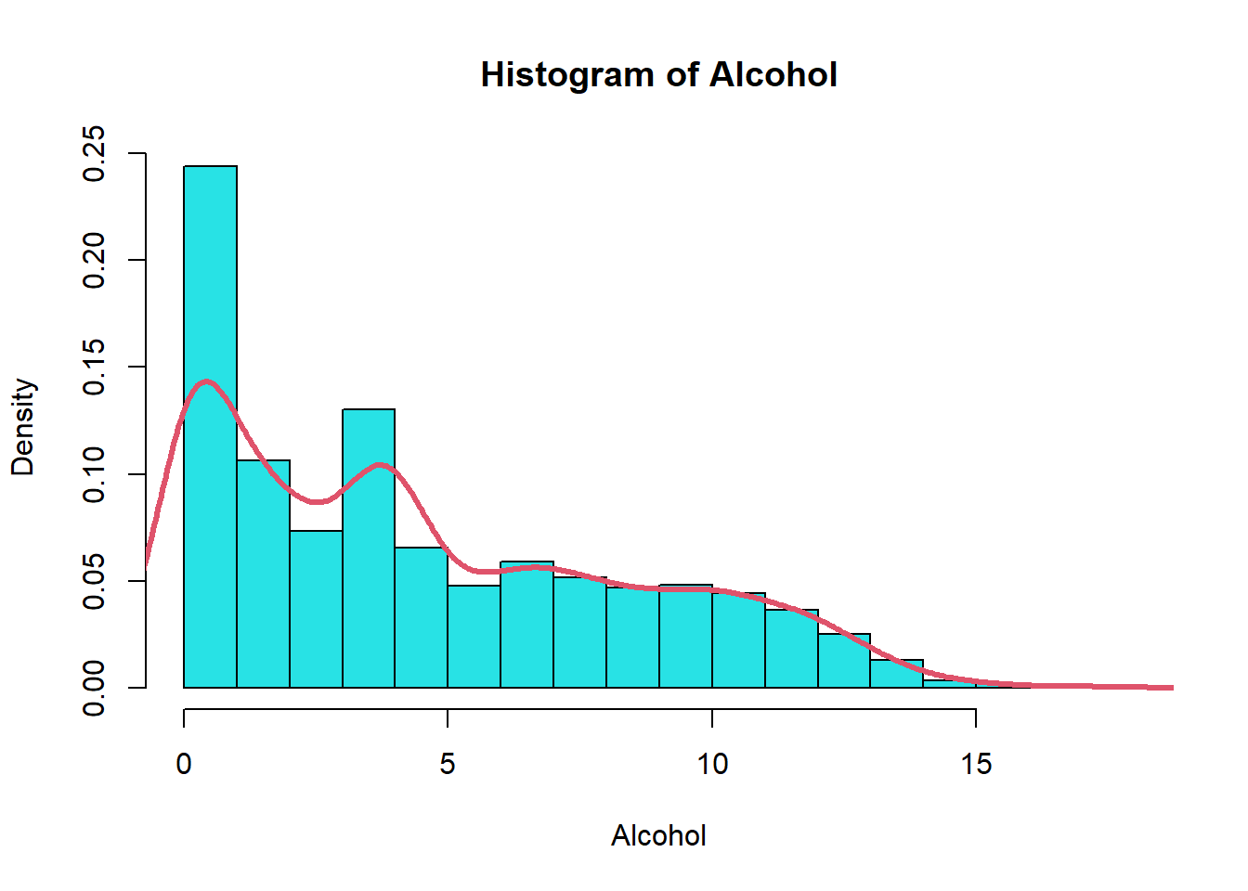
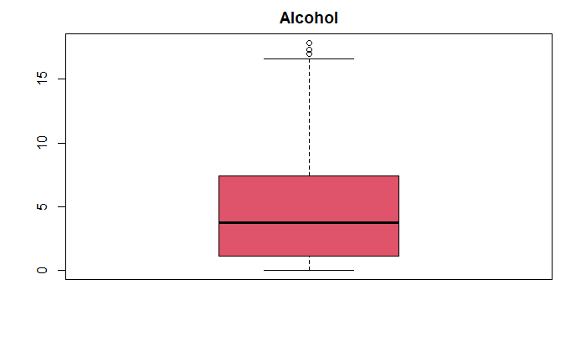
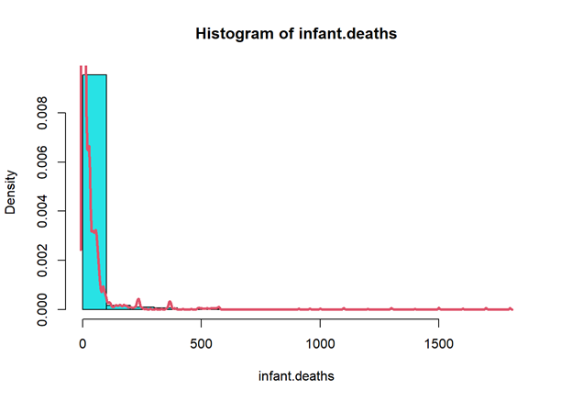
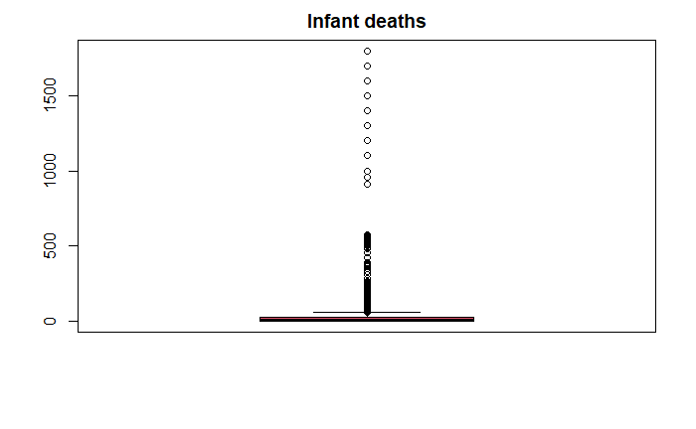
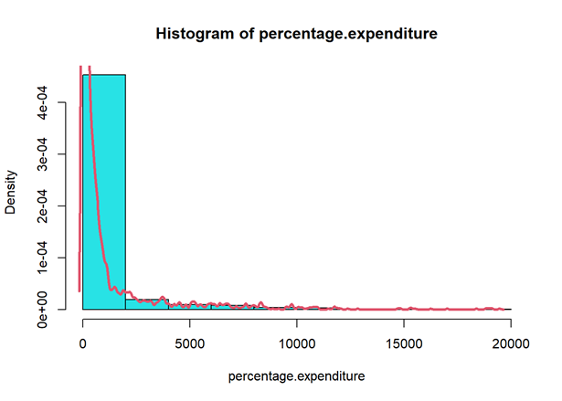
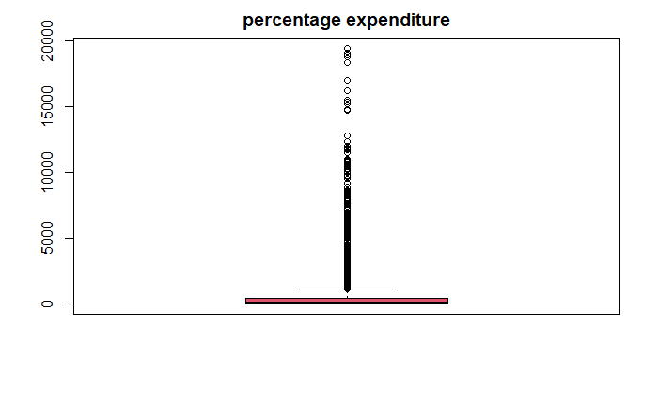
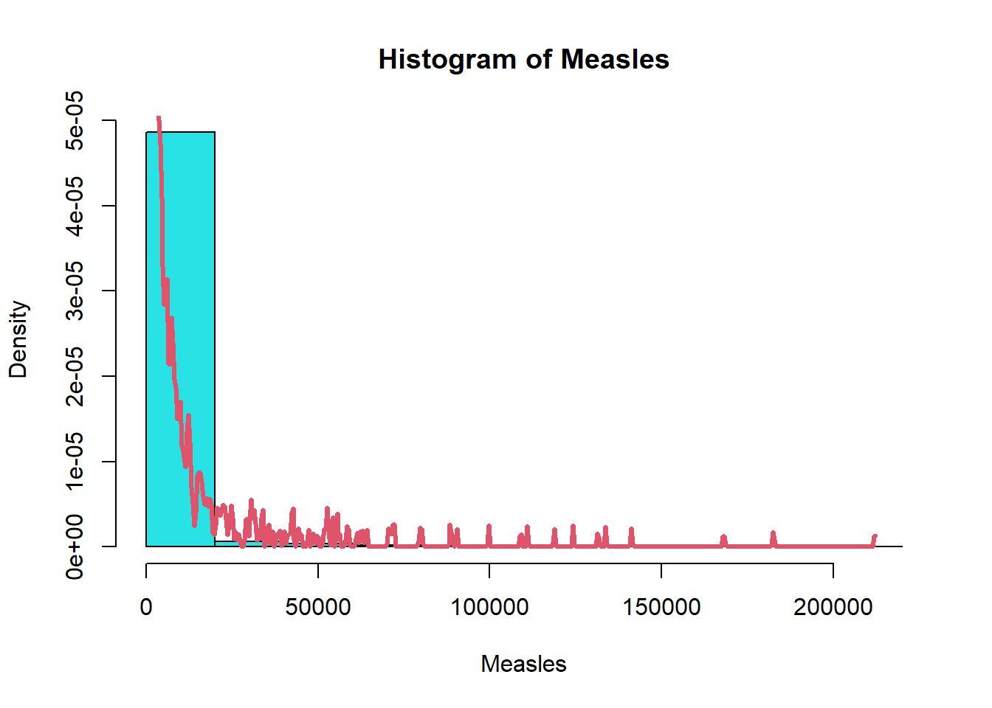
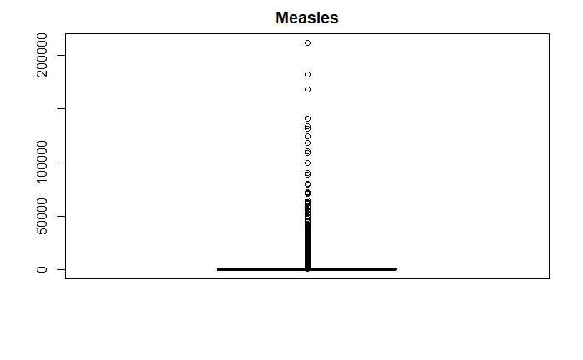
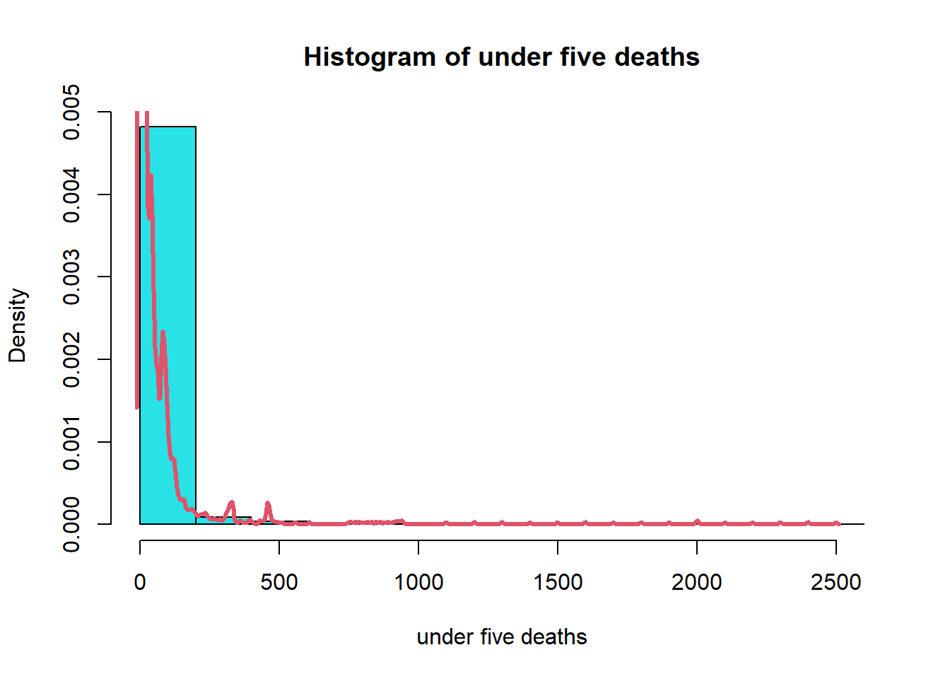
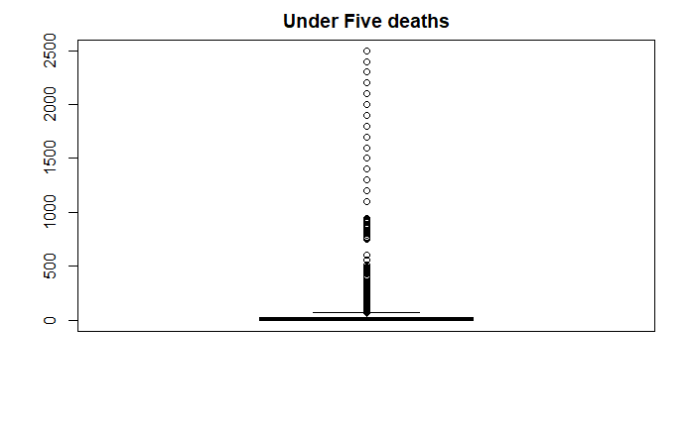
DATA- VISUALISATION

Slide 8
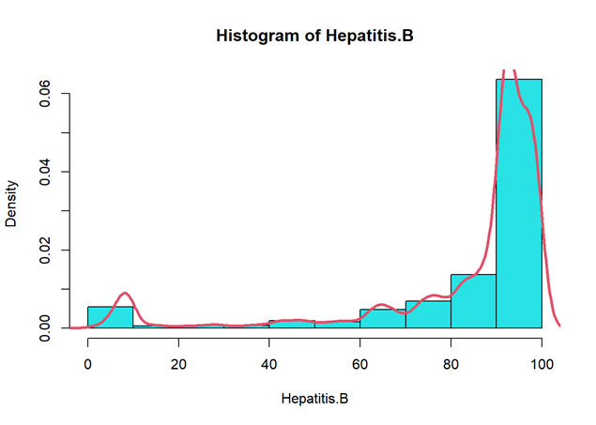
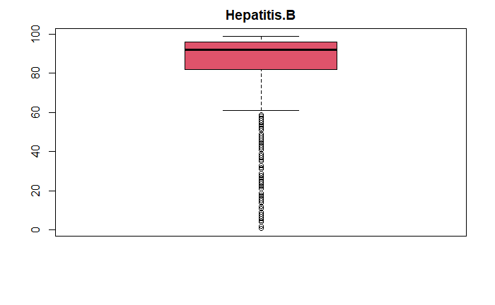
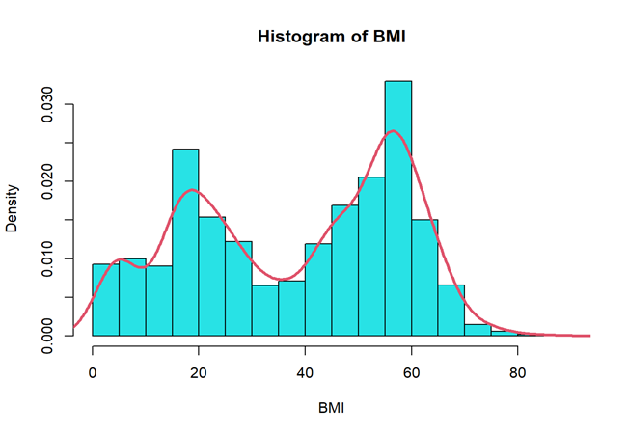
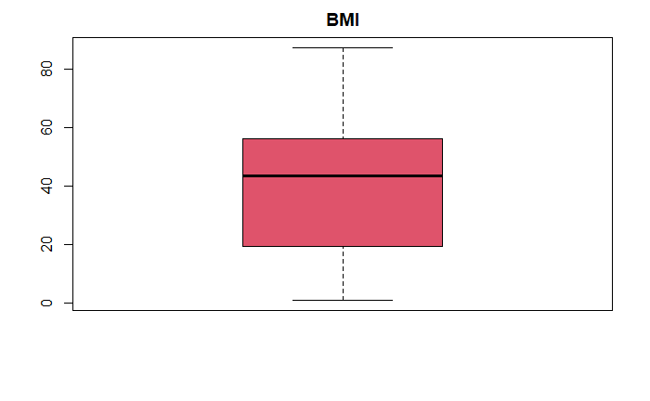
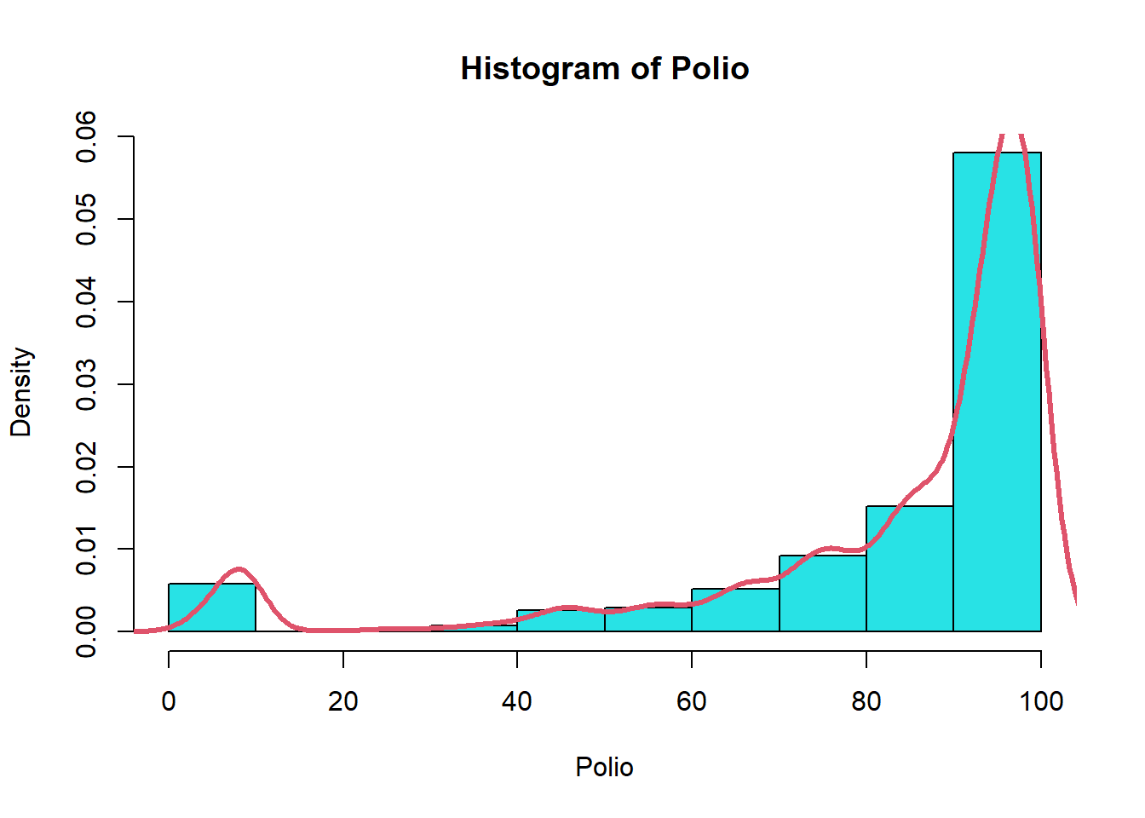
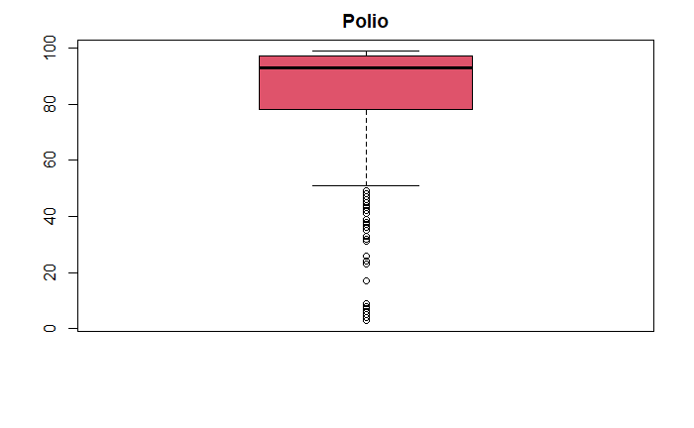
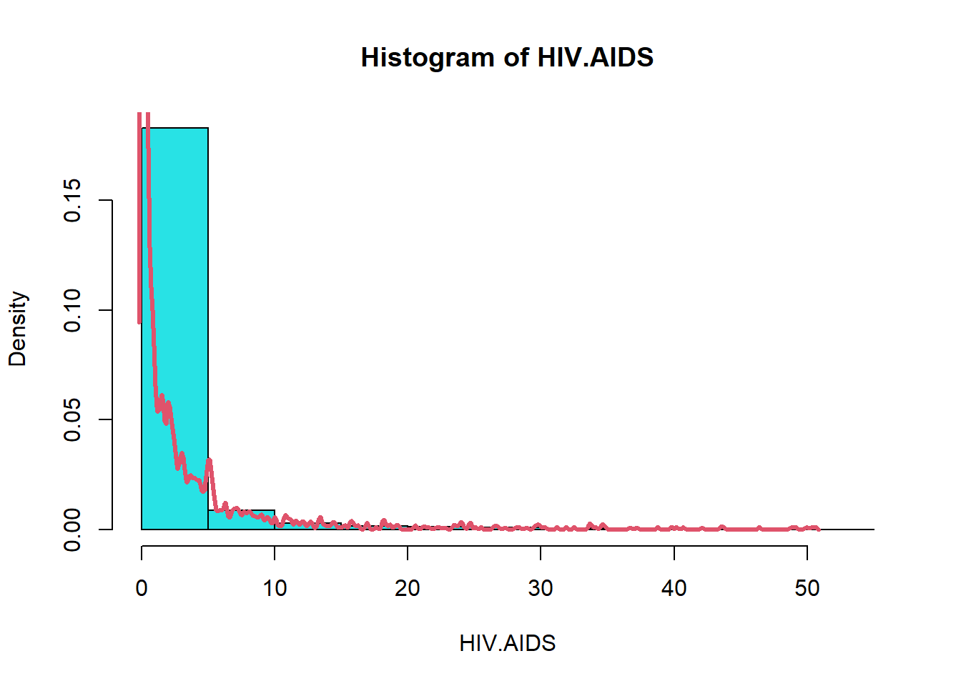
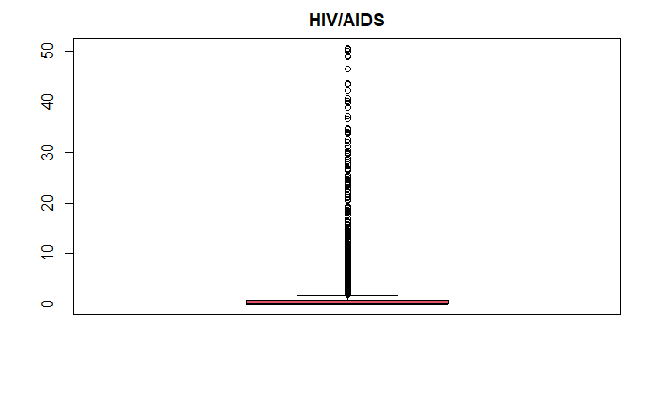
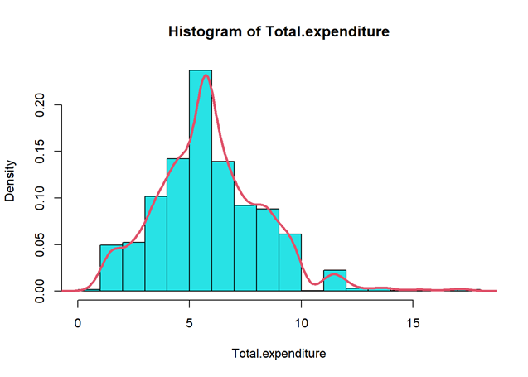
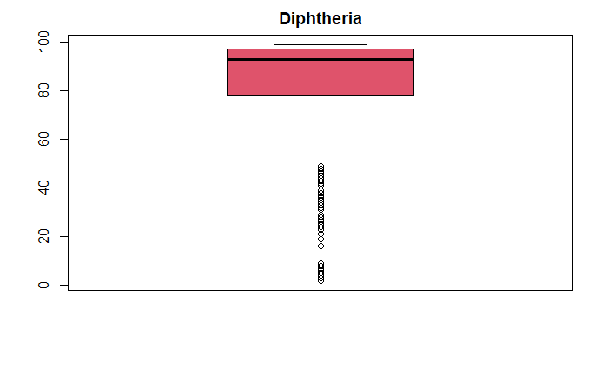
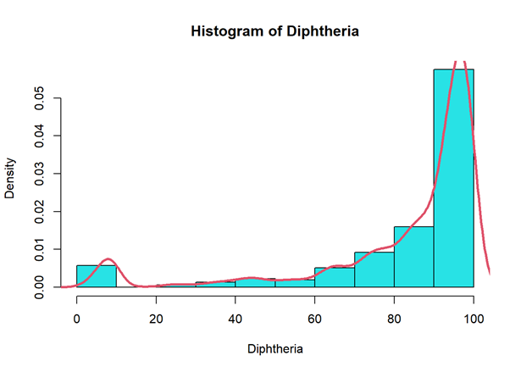
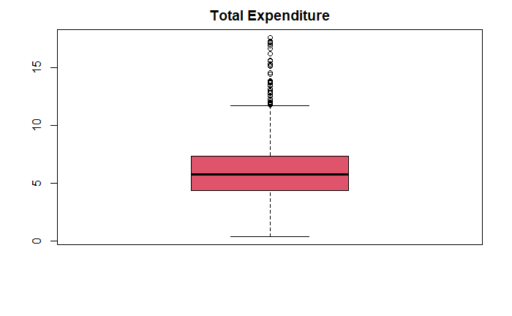

Slide 9
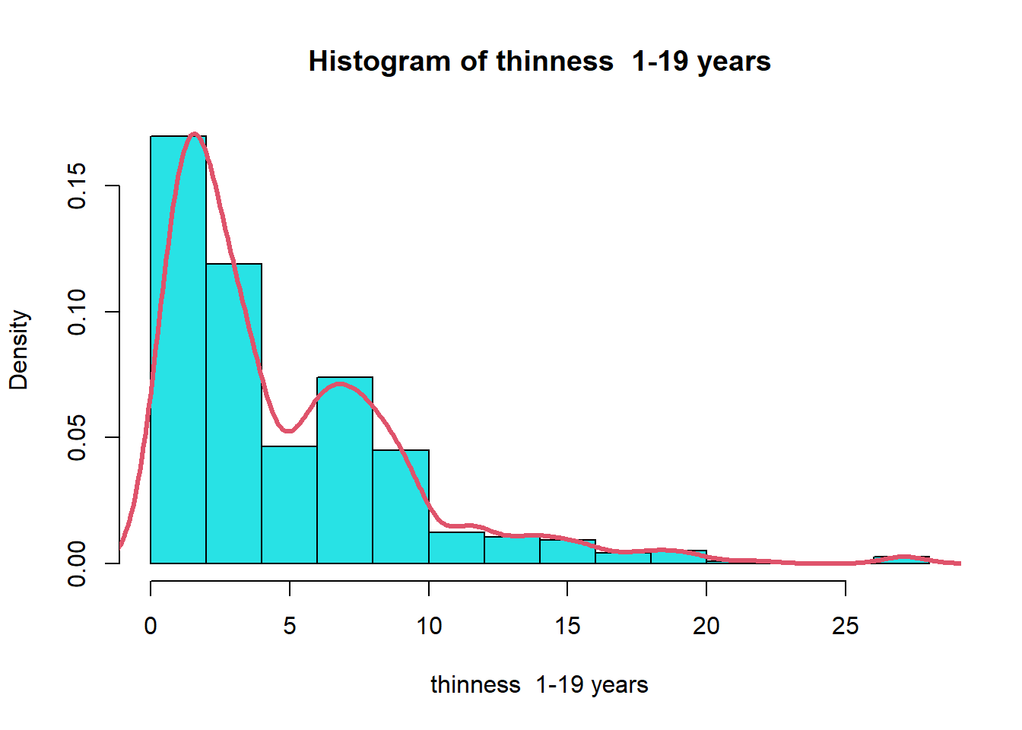
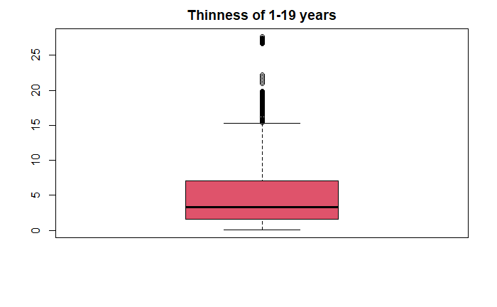
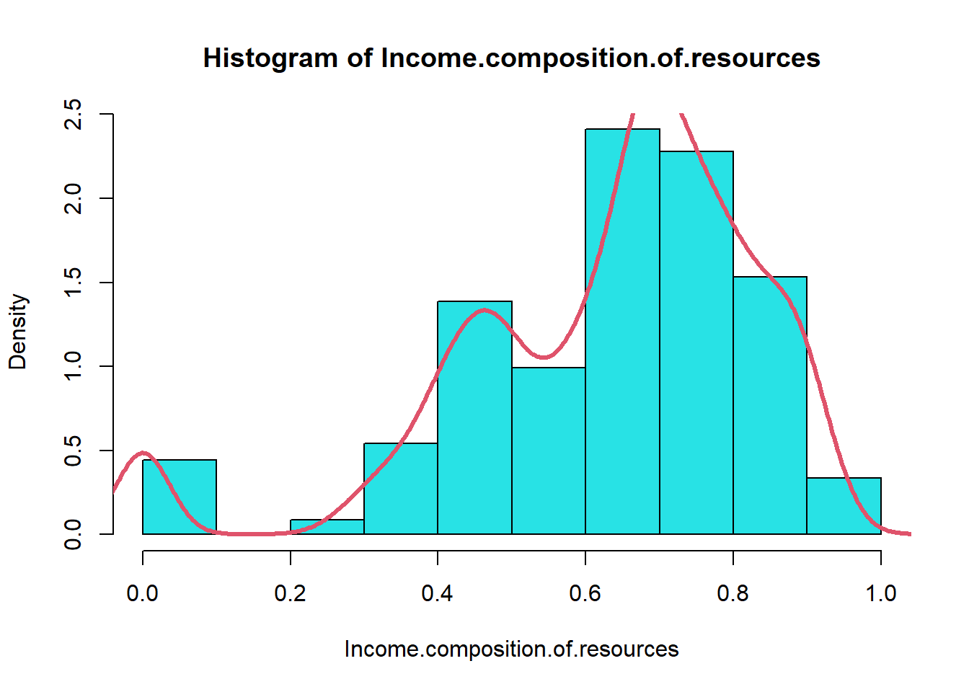
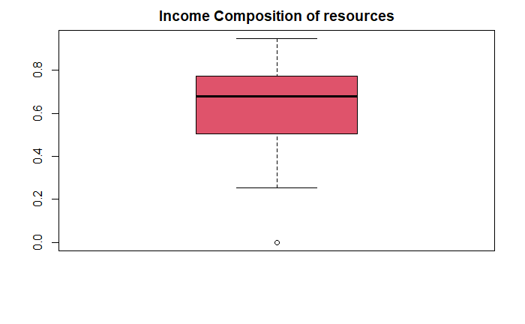
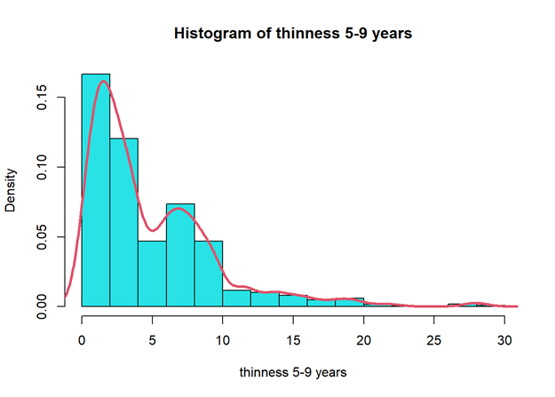
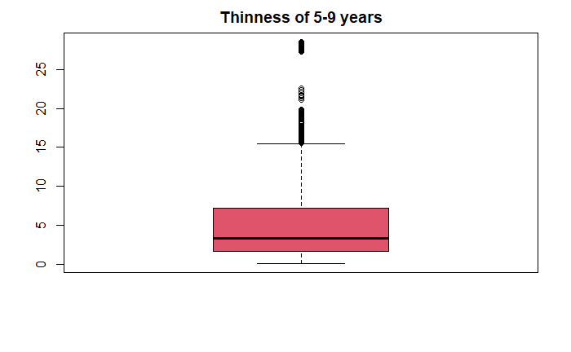
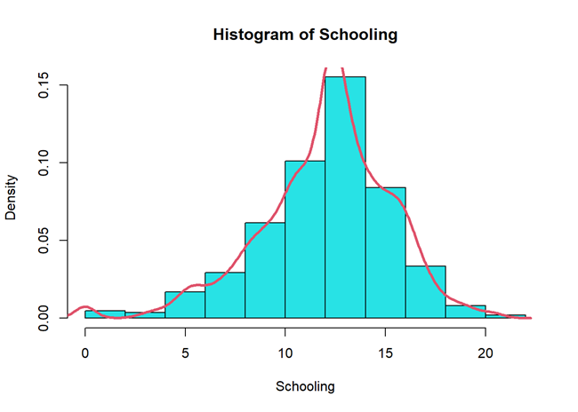
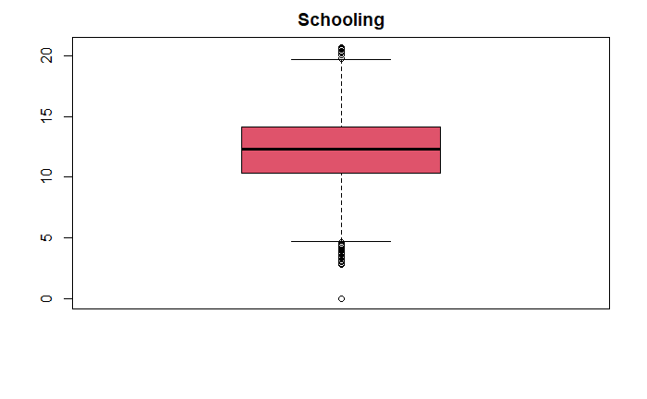

Slide 10
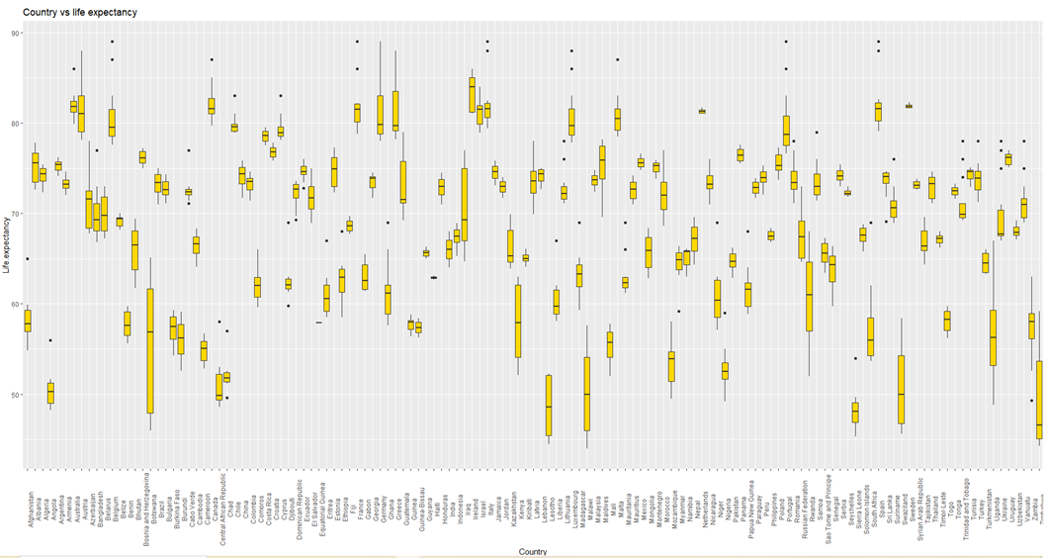
Japan is the country with the highest Life expectancy value
followed by Sweden and Sierra
Leone has the lowest Life expectancy value

Slide 11
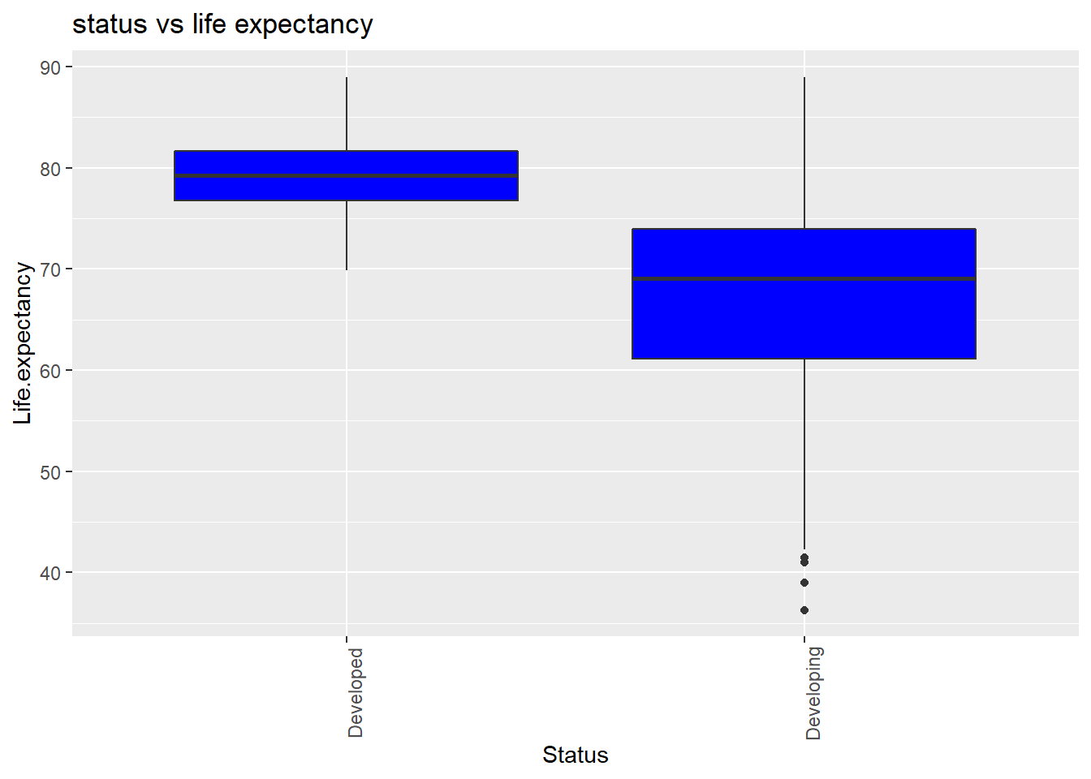
The life expectancy value in case of developing countries is low whereas in case of Developed countries the life expectancy value is comparatively high.

Slide 12
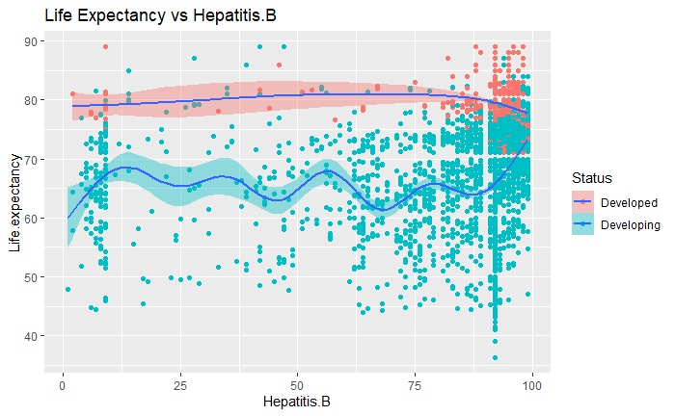
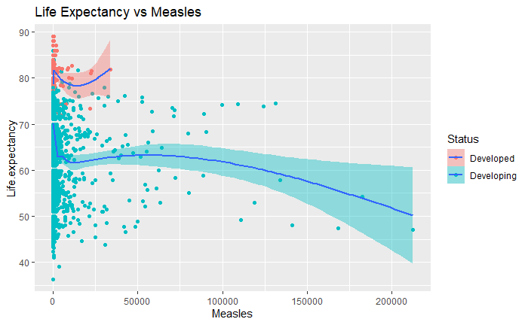
EFFECT OF DISEASE ON LIFE EXPECTANCY
here is a slight decrease in the life expectancy value in case of developed countries whereas in case of Developed countries the life expectancy value is gradually rising which means that developing countries are taking measures for setting up vaccine of hepatitis B
In case of Measles, according to the graph the developed countries seems to have vaccines available to tackle measles whereas developing countries life expectancy values is decreasing day by day maybe because of lack of resources to handle measles

Slide 13
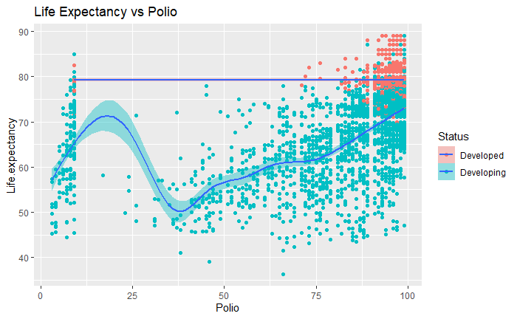
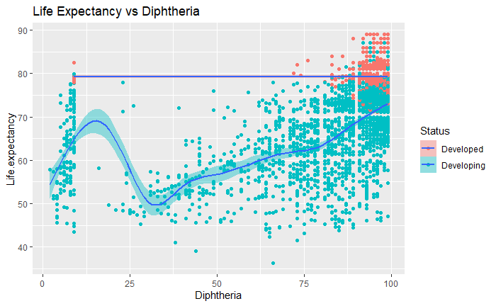
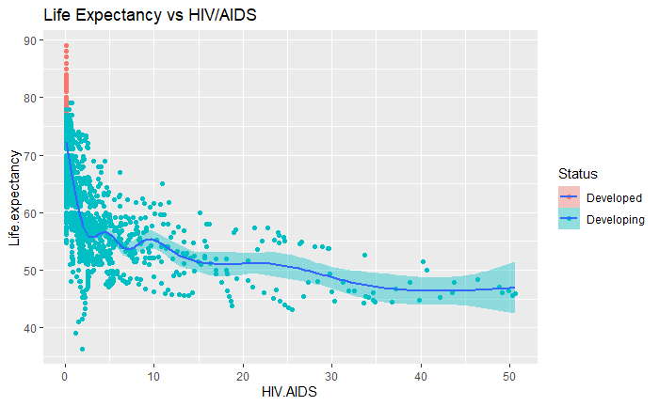
Developed countries seems to have successfully eradicated polio diesease because of vaccines whereas in developing countries there was low expectancy value initially but now it is gradually increasing maybe because of proper doses being given
Developed countries seems to have successfully eradicated diptheria diesease because of vaccines whereas in developing countries there was low expectancy value initially but now it is gradually increasing maybe because of proper doses being given
The graph shows that developing countries still have not been able to handle HIV/AIDS at all as the life expectancy value is decreasing at a rapid range. This can be due to rising population and poor awareness about AIDS.

Slide 14
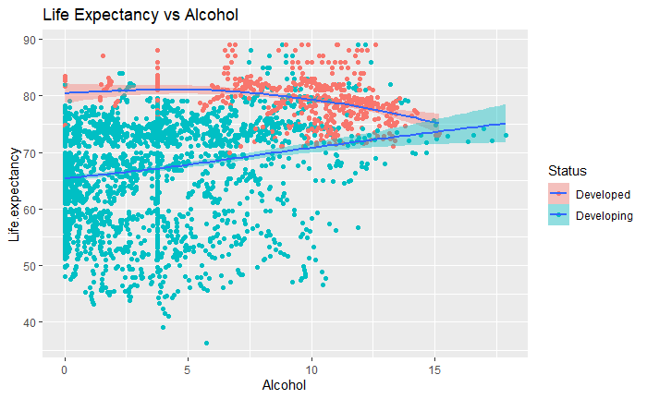
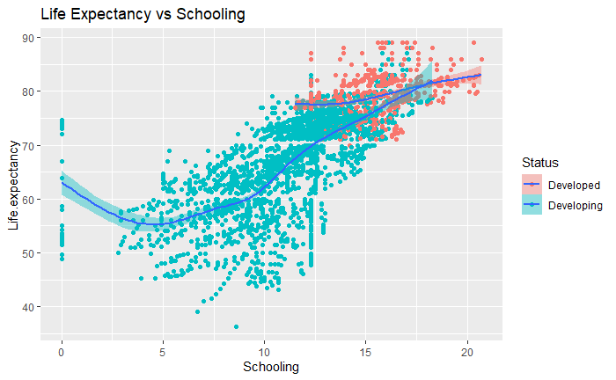
EFFECT OF SOCIAL PARAMETERS ON LIFE EXPECTANCY
Developing countries and alcohol have positive relation and developed countries and alcohol have negative relation
Schooling can effect life expectancy more in developing countries than developed countries. Due to schooling increasing literacy rate can indirectly affect as good medical facilities for saving life.

Slide 15
MODELLING:

Slide 16
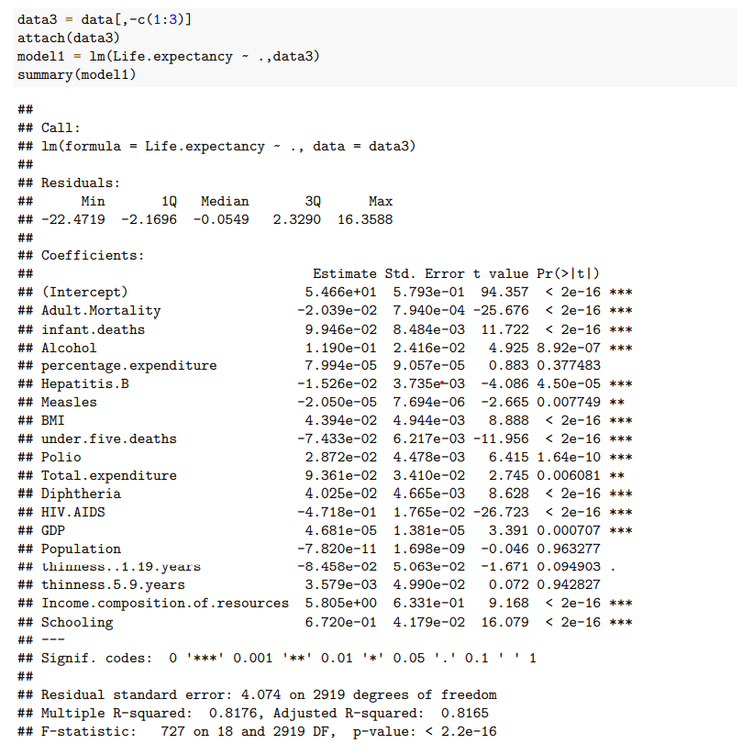
FITTING THE MODEL FOR LIFE EXPECTANCY DATA
Baseline Model:
At first, we are making model taking Life Expectancy as the response variable and all others as predictors.

Slide 17
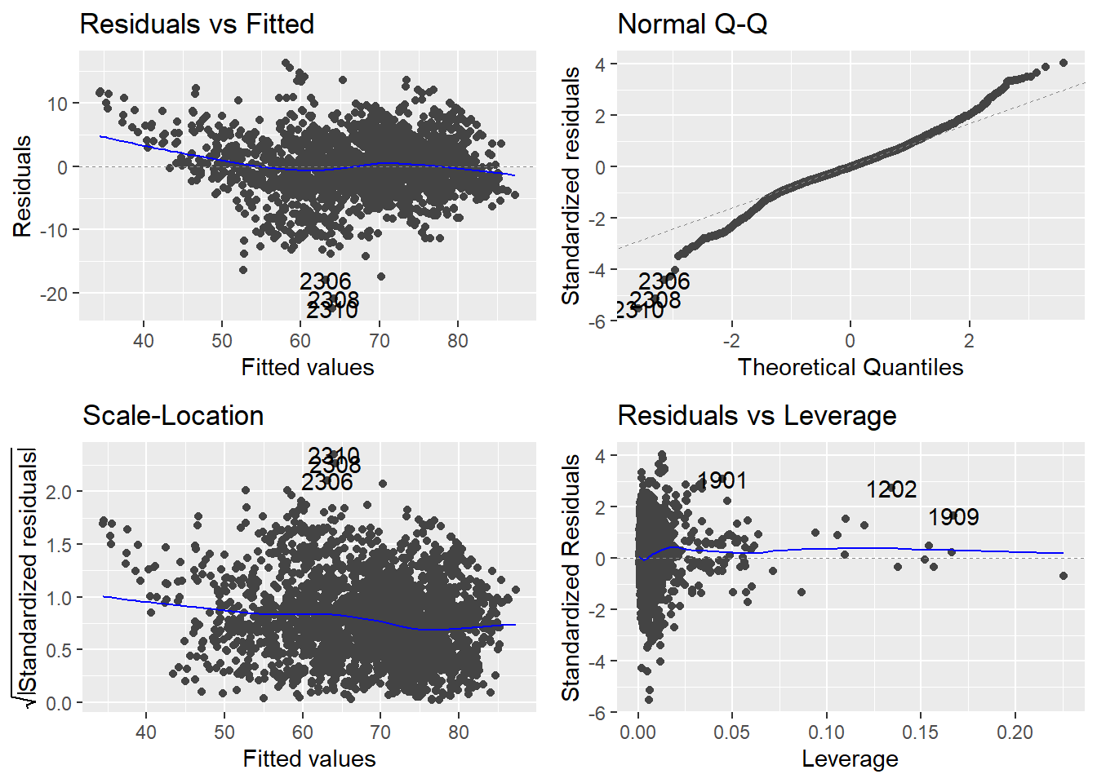
Clearly from the above summary of model1 we can conclude that the following parameters such as percentage expenditure, population, thinness(1-19 years), thinness(5-9 years) are insignificant(p-value of t-test is more than 0.05) to estimate our predictor variable.
Model Diagnosis
Assumption of model can be observed by following four different plots of model1

Slide 18
TESTING ASSUMPTIONS OF MODEL
1. Assumptions of linearity is satisfied by residual VS fitted plot
2. Assumption of homoscedasticity is satisfied by Scale-Location Plot
3. By Normal Q-Q plot assumption of normality is satisfied.
4. Multi-collinearity is to be tested by VIF ( variance inflation factor )
DETECTION OF MULTI-COLLINEARITY
To detect the multi-collinearity we will use VIF method. Hence we calculated VIF with
respect to each predictor variables
Adult.Mortality infant.deaths
1.718038 177.181727
Alcohol percentage.expenditure
1.589377 5.737567
Hepatitis.B Measles
1.305980 1.377767
BMI under.five.deaths
1.719067 176.113622
Polio Total.expenditure
1.937826 1.186037
Diphtheria HIV.AIDS
2.155516 1.422386
GDP Population
5.965483 1.489929
thinness..1.19.years thinness.5.9.years
8.773122 8.869434
Income composition Schooling
Of resources
2.985808 3.296186
Clearly variables like infant deaths, under five deaths have high VIF values > 100 that means it’s highly correlated with other variables causing multi-collinearity.
INSIGHTS FROM MODEL 1
Predictors such as percentage expenditure, population, thinness(1-19 years), thinness(5-9 years), income composition of resources are insignificant hence we will drop those from our model.
Clearly variables like infant deaths, under five deaths have high VIF values > 100. hence they cause Multi-collinearity in the data. Hence we will drop them also.

Slide 19
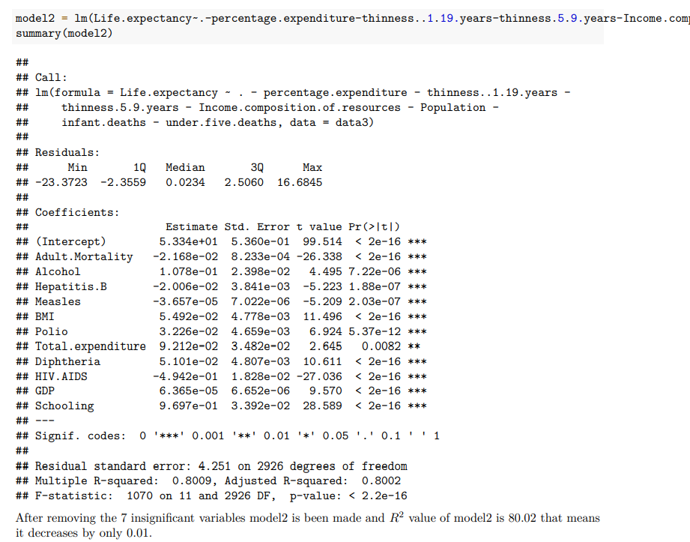
DEFINING MODEL 2
From insights of model 1 we will define a new model without the variables we have decided to drop.
we will define model without 1) percentage expenditure, 2) population, 3) thinness(1-19 years), 4)Thinness(5-9 years), 5) income composition of resources , 6) infant deaths, 7)under five deaths
After removing the 7 insignificant variables model 2 is been made and R-squared value of model 2 is 80.02% that means it decreases by only 0.01 %.

Slide 20
DIAGNOSTICS OF MODEL 2
DIAGNOSIS OF FOUR R-PLOTS
From above four graphs we conclude that model 2 satisfies Linearity , normality , homoscedasticity assumptions.

Slide 21
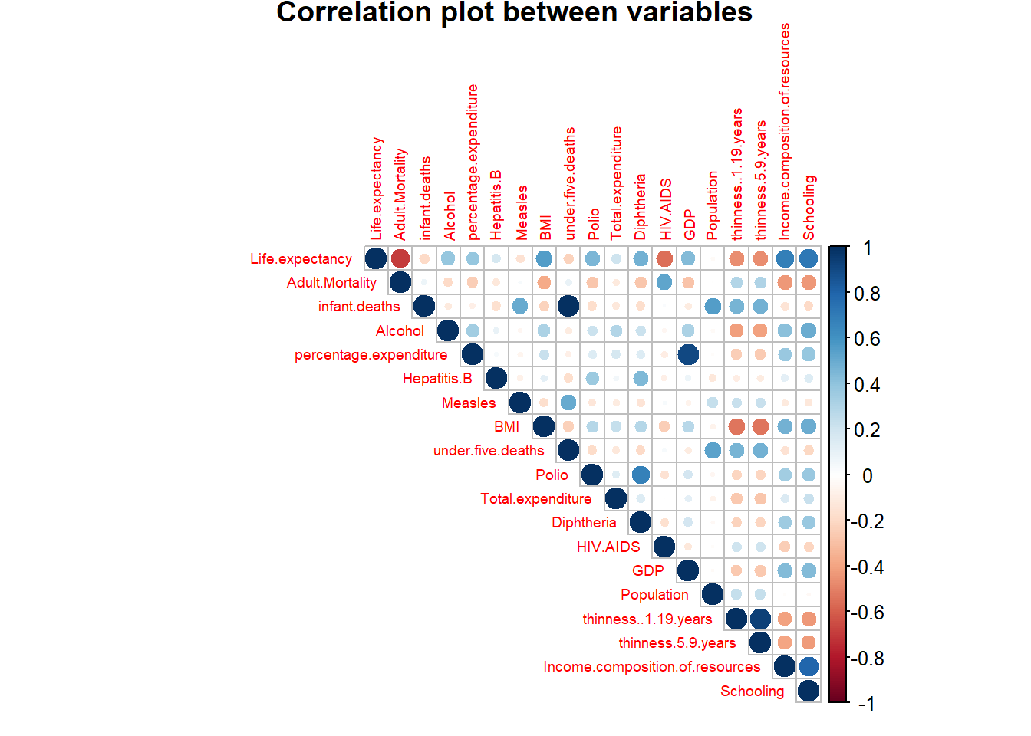
INTERACTION TERMS:
DIAGNOSIS FROM CORRPLOT
From the above correlation plot and correlation value of each variables it is found that a decent amount of correlation exist between Adult-mortality & HIV/AIDS, BMI & thinness(1-19years), BMI & thinness(5-9years), BMI & Schooling, Polio & Diphtheria, Schooling & Income-composition of resources. So their interaction terms are to be added in our model.

Slide 22
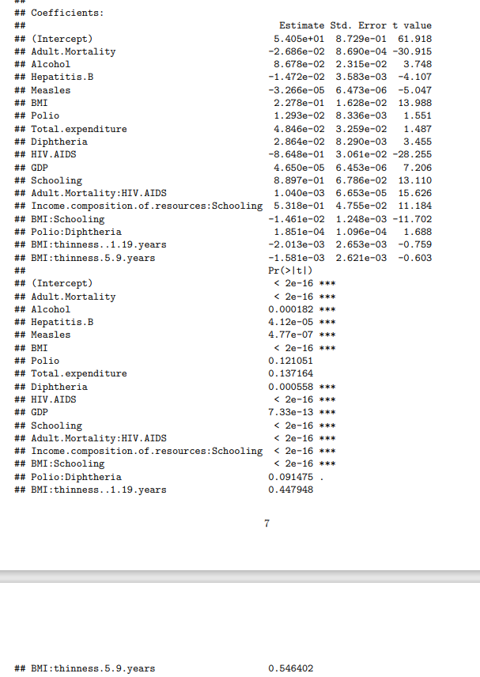
INSIGHTS FROM MODEL 2
Since decent amount of correlation exist between Adult-mortality & HIV/AIDS, BMI & thinness(1-19years), BMI & thinness(5-9years), BMI & Schooling, Polio & Diphtheria, Schooling & Income-composition of resources we will add those interaction terms in the model
Adjusted R-Squared value of model2 was 80%
TEST MODEL 3
New model 3 can be defined by adding interaction terms between Adult-mortality & HIV/AIDS, BMI & thinness(1-19years), BMI & thinness(5-9years), BMI & Schooling, Polio & Diphtheria, Schooling & Income-composition of resources

Slide 23
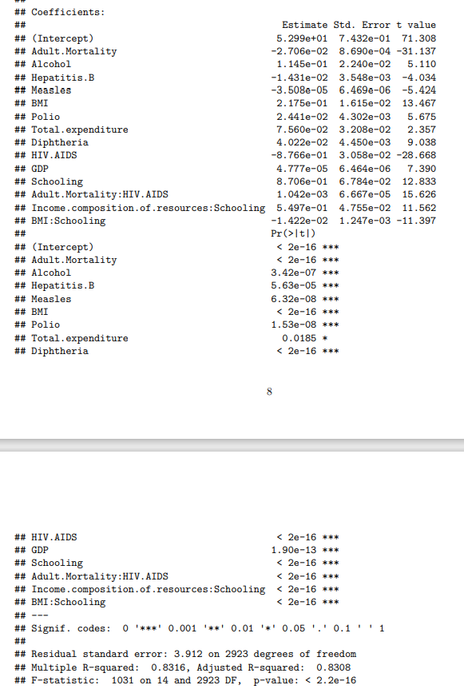
Model3:
Life Expectancy=(52.18)+(-0.0235)* Adult Mortality +(0.1314)*Alcohol+(-0.01116)*Hepatitis B + (-0.000032)*Measles + (0.1943)*BMI+(0.02118)*Polio+(0.08815)*Total expenditure+(0.0357)*Diphtheria}+(0.00005032)*GDP + (0.8188)*Schooling} +(-24.14)*HIV.AIDS +(0.000908)*[Adult Mortality : HIV.AIDS]
+(0.5342)*(Income composition of resources: Schooling) + (-0.01292)*[BMI: Schooling]
After adding significant interaction terms new model 3 defined has value of R-Squared as 83% which is increased by 3% from previous model. Model3 is better than model2
INSIGHTS FROM MODEL 3
Adjusted R-Squared value of model3 was 83%
All assumptions were satisfied by model 3 so our aim is just to increase the value of R-Squared so that model is good fit hence we will add some higher power ( polynomial ) terms.

Slide 24
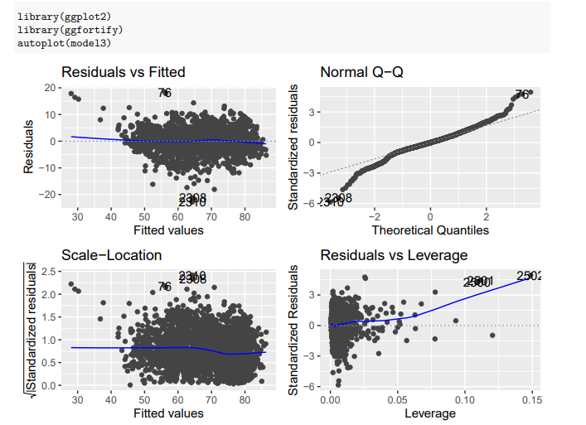
DIAGNOSTIC PLOTS OF MODEL3:

Slide 25
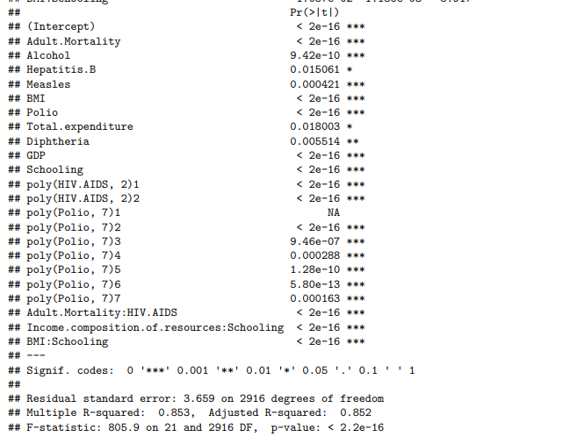
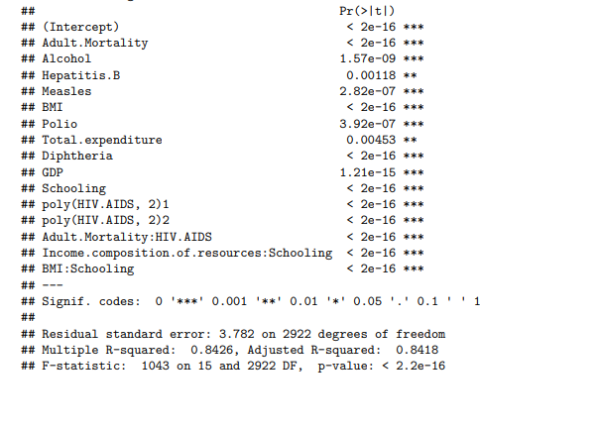
POLYNOMIAL TERMS AND MODEL4:
TEST MODEL 4:
We found model can be improved by adding the 2nd degree polynomial of HIV/AIDS and 7th degree polynomial of Polio.
By adding these 2 polynomials our R2 value increase to 85.20%. But at the cost of 6 more variables.So we are going to drop these variables.
MODEL 4
We Tested tried to add polynomial terms of predictor variables to improve the model
Further on the stake of adding 6 more variables due to the polynomial of Polio the model is improved by only (1%). So it will be better if the polynomial terms of Polio are dropped.
Hence finalized model 4 has all terms of model 3 along with 2nd degree polynomial terms of HIV/AIDS

Slide 26

DIAGNOSTICS OF MODEL 4
DIAGNOSIS OF FOUR R-PLOTS
From above four graphs we conclude that model 2 satisfies
Linearity , normality , homoscedasticity assumptions.

Slide 27
CONCLUSION OF MODEL :-
1)R-Squared value of our final model is (84.18%). 2)From the residual vs fitted graph we can see that the estimated error curve of our final model is almost converge to 0. 3)From the QQ-Plot we can see that the our model shows behave like normal except for the tail parts.
FINAL MODEL:-
Life Expectancy=(52.18)+(-0.0235)* Adult.Mortality+(0.1314)*Alcohol+(-0.01116)*Hepatitis.B+
(-0.000032)*Measles + (0.1943)*BMI+(0.02118)*Polio+(0.08815)*Total.expenditure+
(0.0357)*Diphtheria}+(0.00005032)*GDP + (0.8188)*Schooling} +(-24.14)*HIV.AIDS +
(60.78)*(HIV.AIDS)^2+(0.000908)*[Adult.Mortality:HIV.AIDS]+
(0.5342)*(Income.composition.of.resources:Schooling)+(-0.01292)*[BMI:Schooling]

Slide 28
PROJECT SUMMARY:-
The dataset although collected by WHO contained a lot of missing values and we saw that most of the missing values were from the countries with very less population and were data collection is a very tedious task.
A lot of outliers were detected which could not be removed because doing so we could loose a lot of information.
Japan although being hit badly by world war II came back very strong and is currently the country with the highest life expectancy followed by Sweden which is a big Achievement.
We largely saw how developing countries have very less life expectancy when we see diseases like HIV/AIDS, polio etc. and how Schooling plays a big role in increasing the life expectancy of developing countries as people become much more educated and help improve the welfare and healthcare of the country along with economy.
Alcoholism is a big issue in the developed country where people have good amount of money to spend and this shows how careless are people in terms of their health when it comes to alcoholism.
Life Expectancy model is affected by the factors Adult mortality rate, GDP of the country, by the diseases named as Hepatitis B , Polio, Measles, Diphtheria , HIV/AIDS, and by some their factors too such as BMI, Alcoholism, Total expenditure, Schooling.

